Slide 1
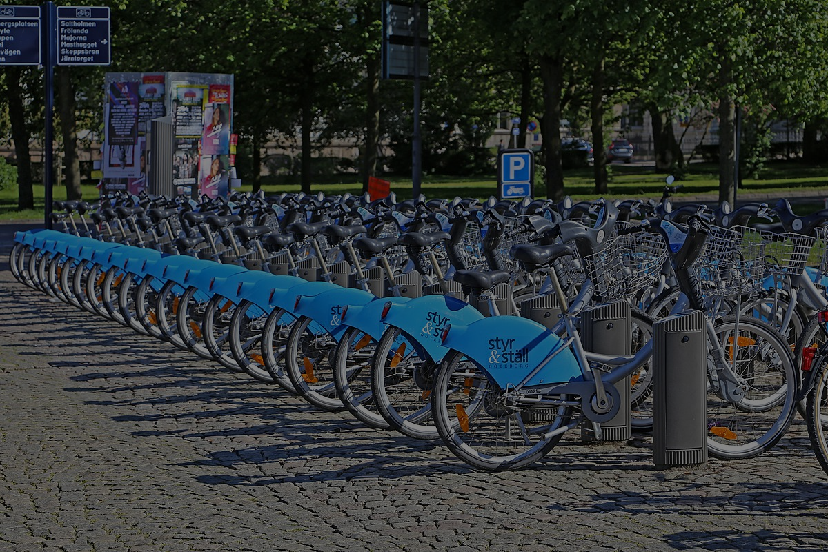
Bike Demand
Kai Sun, Binghong Xie, Wenyi Li, Xinzhu Zhang

Slide 2
Problem Identification
Predict hourly bike sharing demand in each of the following regions individually:
Downtown LA
North Hollywood
Westside
Jointly
What we did in the final project
Explore the data and do exploratory analysis
Perform model selection model based on several scenarios
Use Metric: RMSE
Notes:
Predict hourly bike sharing demand in each of the following regions individually:Downtown LA, Central LA, North Hollywood and the Westside and jointly

Slide 3
Data Overview & Model
Time: From 2016-7-7 to 2021-9-30 (Exclude data before 2016-9-1 because the program just launched)
Total days: 1912 days
Unit time: Hourly data
# of datapoint: 45888
Model:
Arima + Decomption(mstl)
Snaive
Exponential Smoothing
neural network
Linear regression

Slide 4
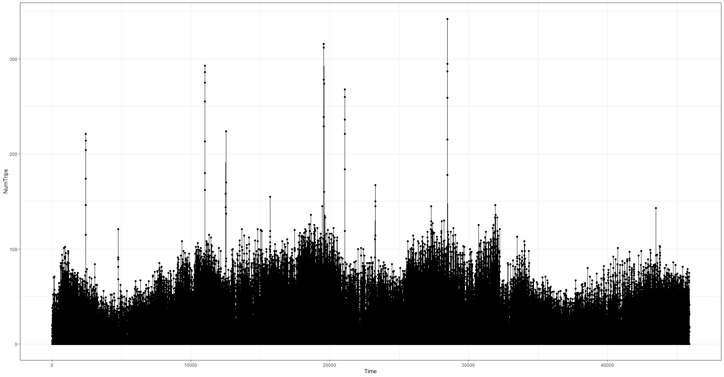
Overall trend

Slide 5
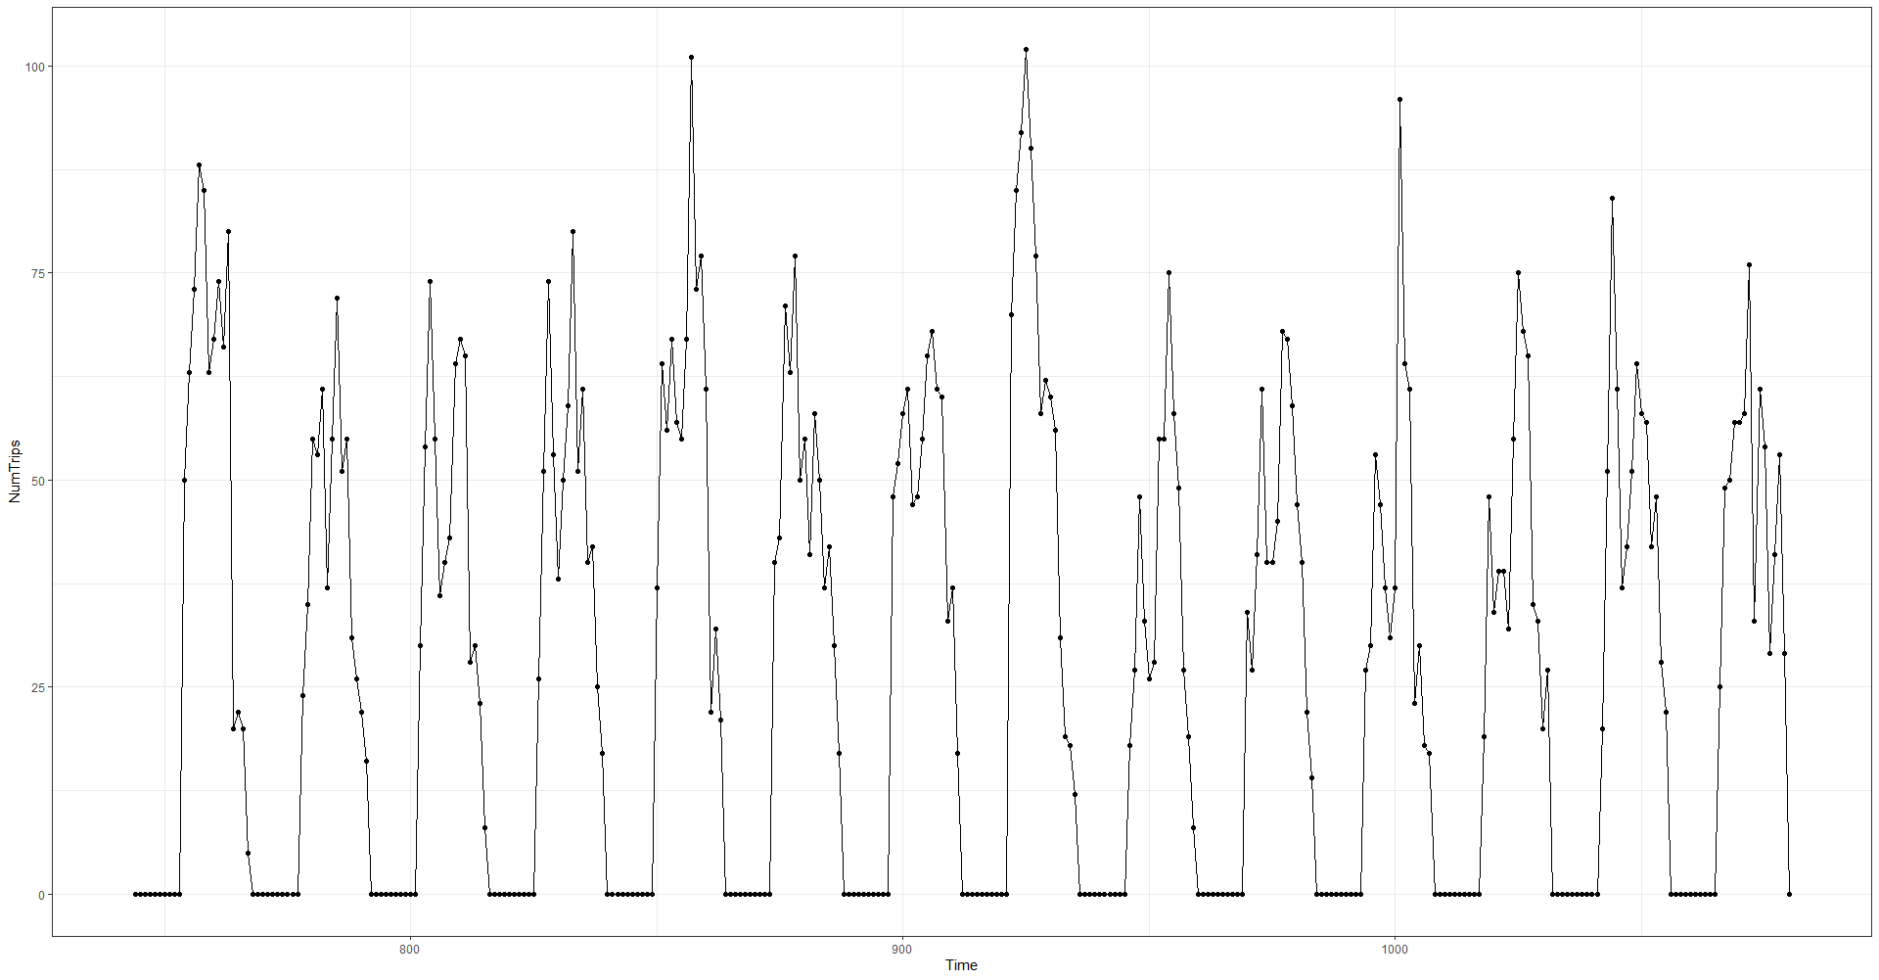
2 weeks of data

Slide 6
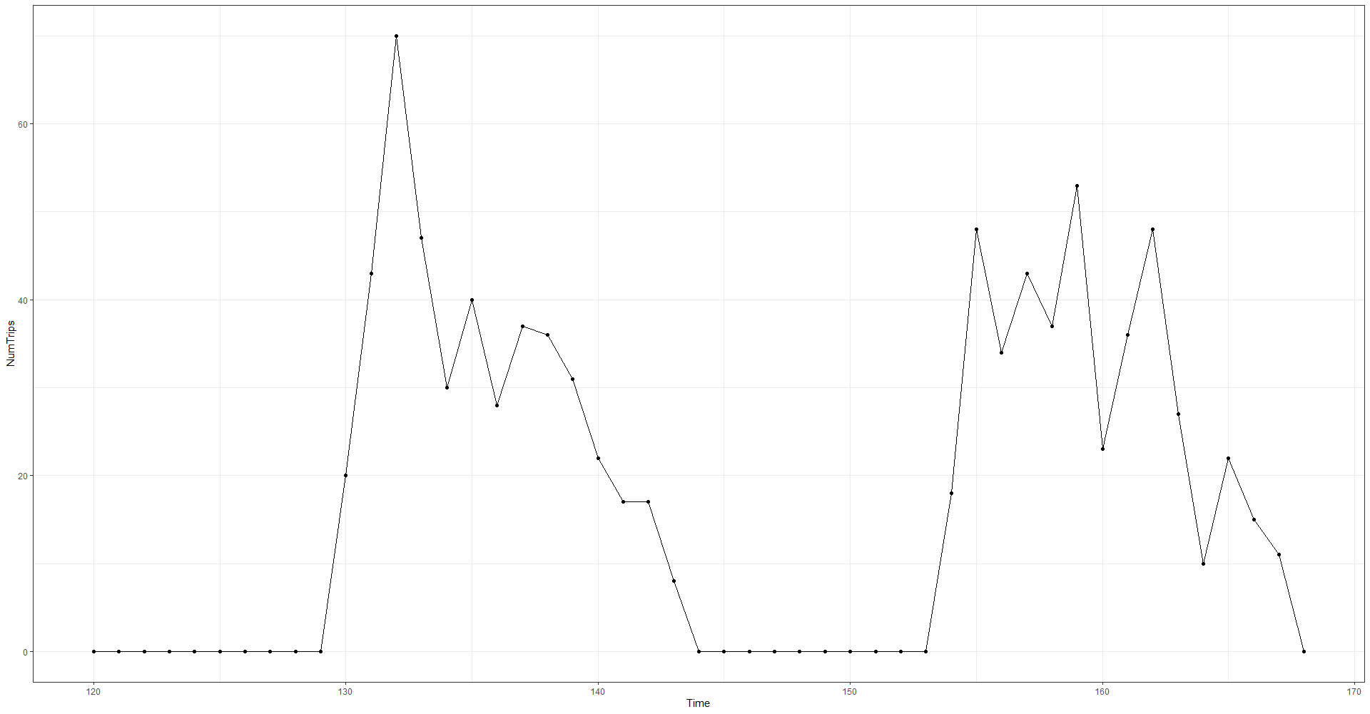
2 days of data

Slide 7
Westside
From 2017-9-1 to 2021-9-30
Exclude data before 2017-10-1
Scenarios | Training | Testing
1 | 2017 Q4 - 2019 Q3 | 2019 Q4
2 | 2017 Q4 - 2020 Q3 | 2020 Q4
3 | 2017 Q4 - 2021 Q2 | 2021 Q3

Slide 8
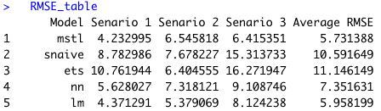
Westside: Models
Champion: Decomposition+ARIMA

Slide 9
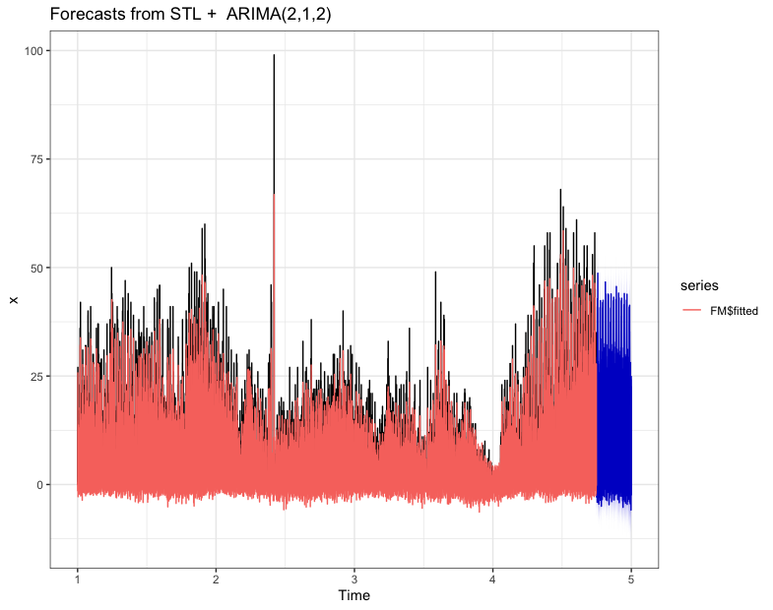
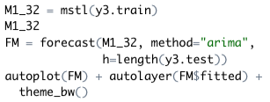
Westside: Decomposition + Arima
Senario 3:
Train: 2017 Q4 - 2021 Q2
Test: 2021 Q3
Code:

Slide 10
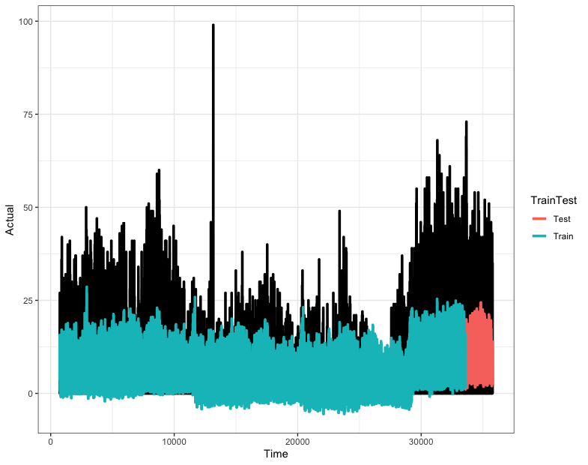
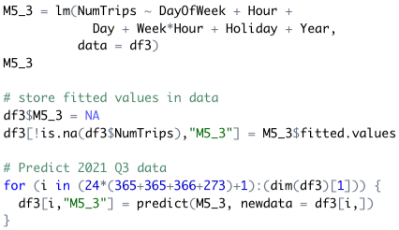
Westside: Linear Regression
Senario 3:
Train: 2017 Q4 - 2021 Q2
Test: 2021 Q3
Code:

Slide 11
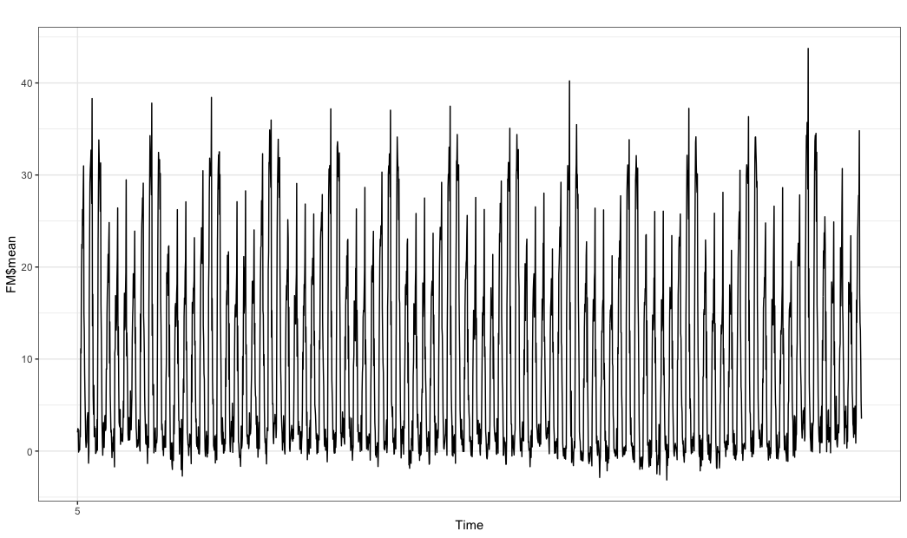
Westside: Prediction (Decomposition + arima)
Total demands in 2021 Q4： 20944
Average daily demand: 228
Hourly demand range: 0 ~ 45

Slide 12
Downtown LA: Data
From 2016-07-07 to 2021-9-30
Scenarios | Training | Testing
1 | 2016 Q4 - 2019 Q3 | 2019 Q4
2 | 2016 Q4 - 2020 Q3 | 2020 Q4
3 | 2016 Q4 - 2021 Q2 | 2021 Q3
Notes:
For the next two regions: downtown LA and North Hollywood we tried the same models. Downtown LA has data from the third quarter of 2016, and we divide the data in the following 3 scenarios.

Slide 13
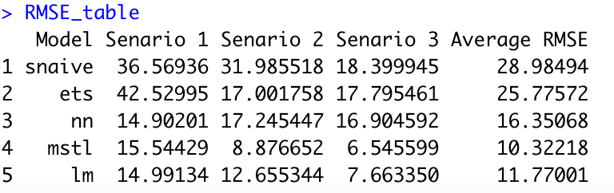
Downtown LA: Models
Champion: Decomposition+ARIMA
Notes:
The champion model for downtown LA is the arima model with decomposition, which result in a minimum average RMSE of 10.3

Slide 14
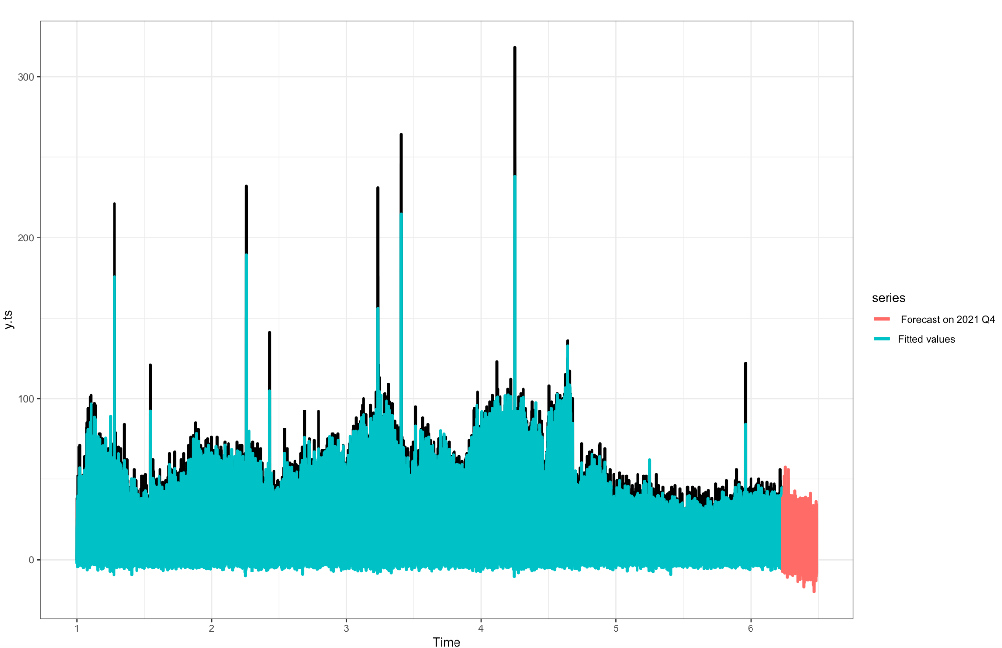
Downtown LA: Prediction
Total demands in 2021 Q4: 21009
Average daily demand: 228
Hourly demand range: 0 ~ 58
Notes:
This slide shows the prediction of Bike demand in DTLA during the fourth quarter of 2021. The predicted demand in DTLA is similar that of westside.

Slide 15
North Hollywood
North Hollywood’s data starts in 2019-06-01, so we use data from 2019Q3
Scenario 1:
Train: 2019Q3 - 2020Q3
Test: 2020Q4
Scenario 2:
Train: 2019Q3 - 2021Q2
Test: 2021Q3
Notes:
North Hollywood has data from the third quarter of 2019, and we divide the data in 2 scenarios.

Slide 16
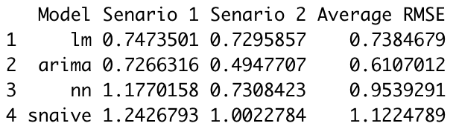
North Hollywood: Models
Champion: ARIMA
Notes:
The champion model for north Hollywood is arima with fourier regression, which has the least average RMSE of 0.61

Slide 17
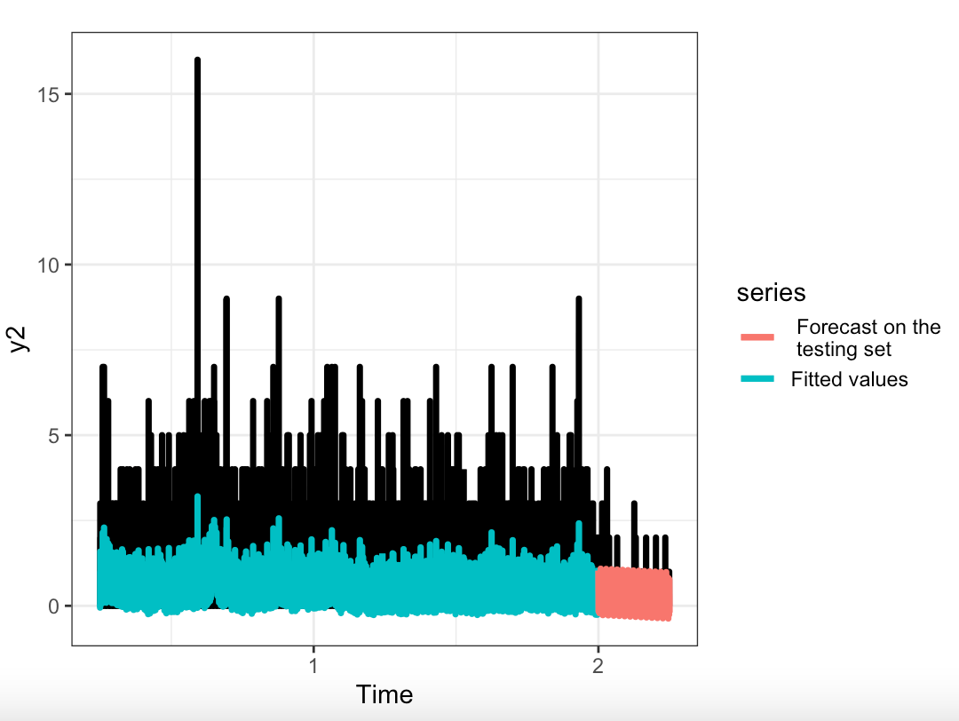
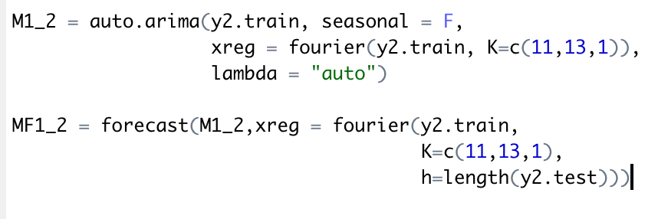
North Hollywood: Prediction
Scenario 2：
Train: 2019Q3 - 2021Q2
Test: 2021Q3
Code：
Prediction：
Total demands in 2021 Q4: 669
Average daily demand: 8
Notes:
This slide shows the fitted prediction of Bike demand in North Hollywood. The total demand in Q4 is predicted to be 669

Slide 18
Joined data
From 2016-9-1 to 2021-9-30
Exclude data before 2016-9-1
Scenarios | Training | Testing
1 | 2016 Q3 - 2019 Q3 | 2019 Q4
2 | 2016 Q3 - 2020 Q3 | 2020 Q4
3 | 2016 Q3 - 2021 Q2 | 2021 Q3

Slide 19
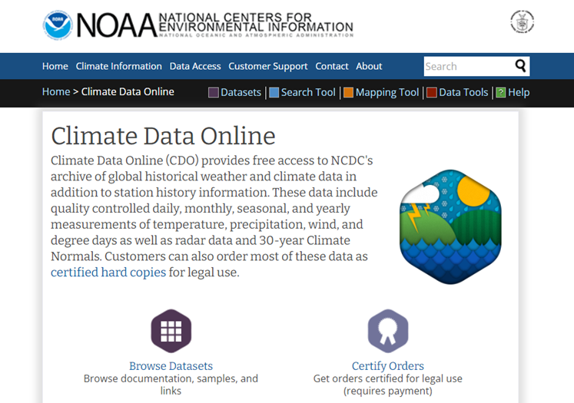
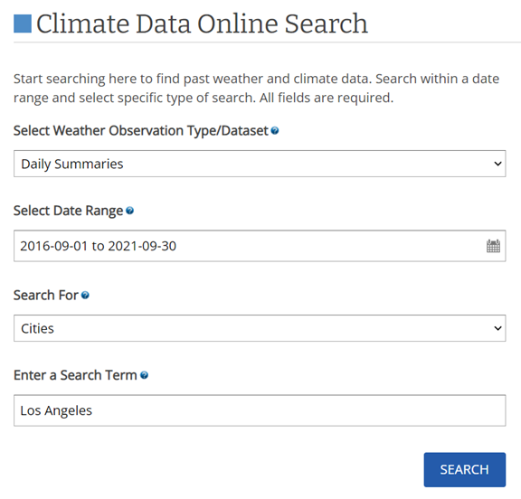
Joined Data: Incorporated LA Daily Weather Data
From National Center for Environmental Information (NOAA): https://www.ncdc.noaa.gov/cdo-web/

Slide 20
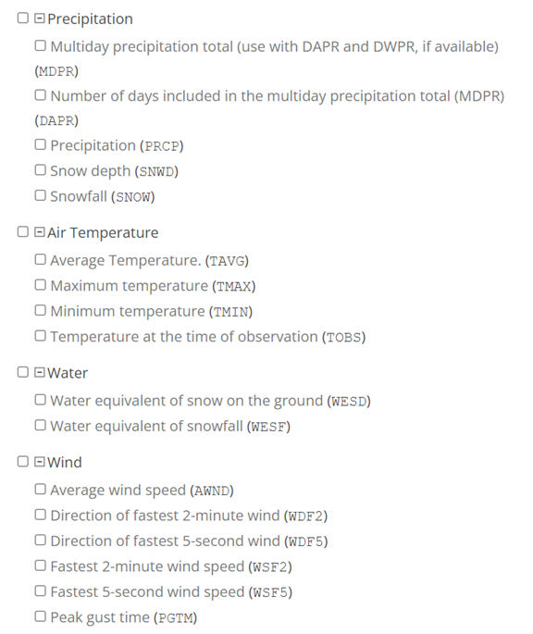
Added 3 features to lm model:
PRCP: precipitation
TAVG: Average temperature
AWND: Average wind speed

Slide 21
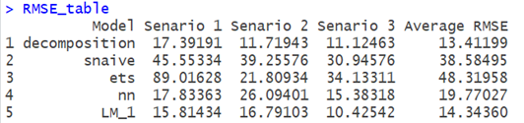
Joined: Models
Champion: Decomposition+ARIMA

Slide 22
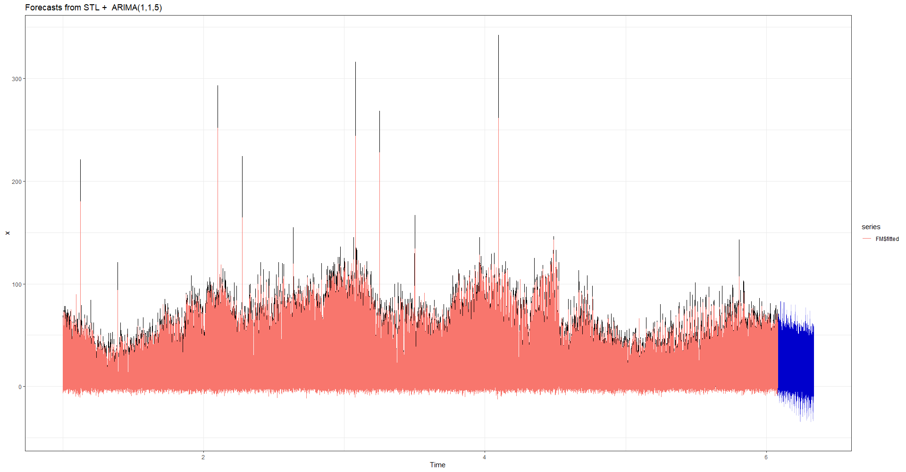
Joined: Prediction
- Total demands in 2021 Q4: 39386.99
- Average daily demand: 423.516
- Average Hourly Demand: 17.6465

Slide 23
Further Improvement
0 values: Build models excluding period with 0 demand
Investigate outliers
Potentially add more features other than weather data
Look at daily/weekly/monthly trend/predictions, which makes daily weather data more usable
Try more ML models (e.g. xgboost, rf)

Slide 24
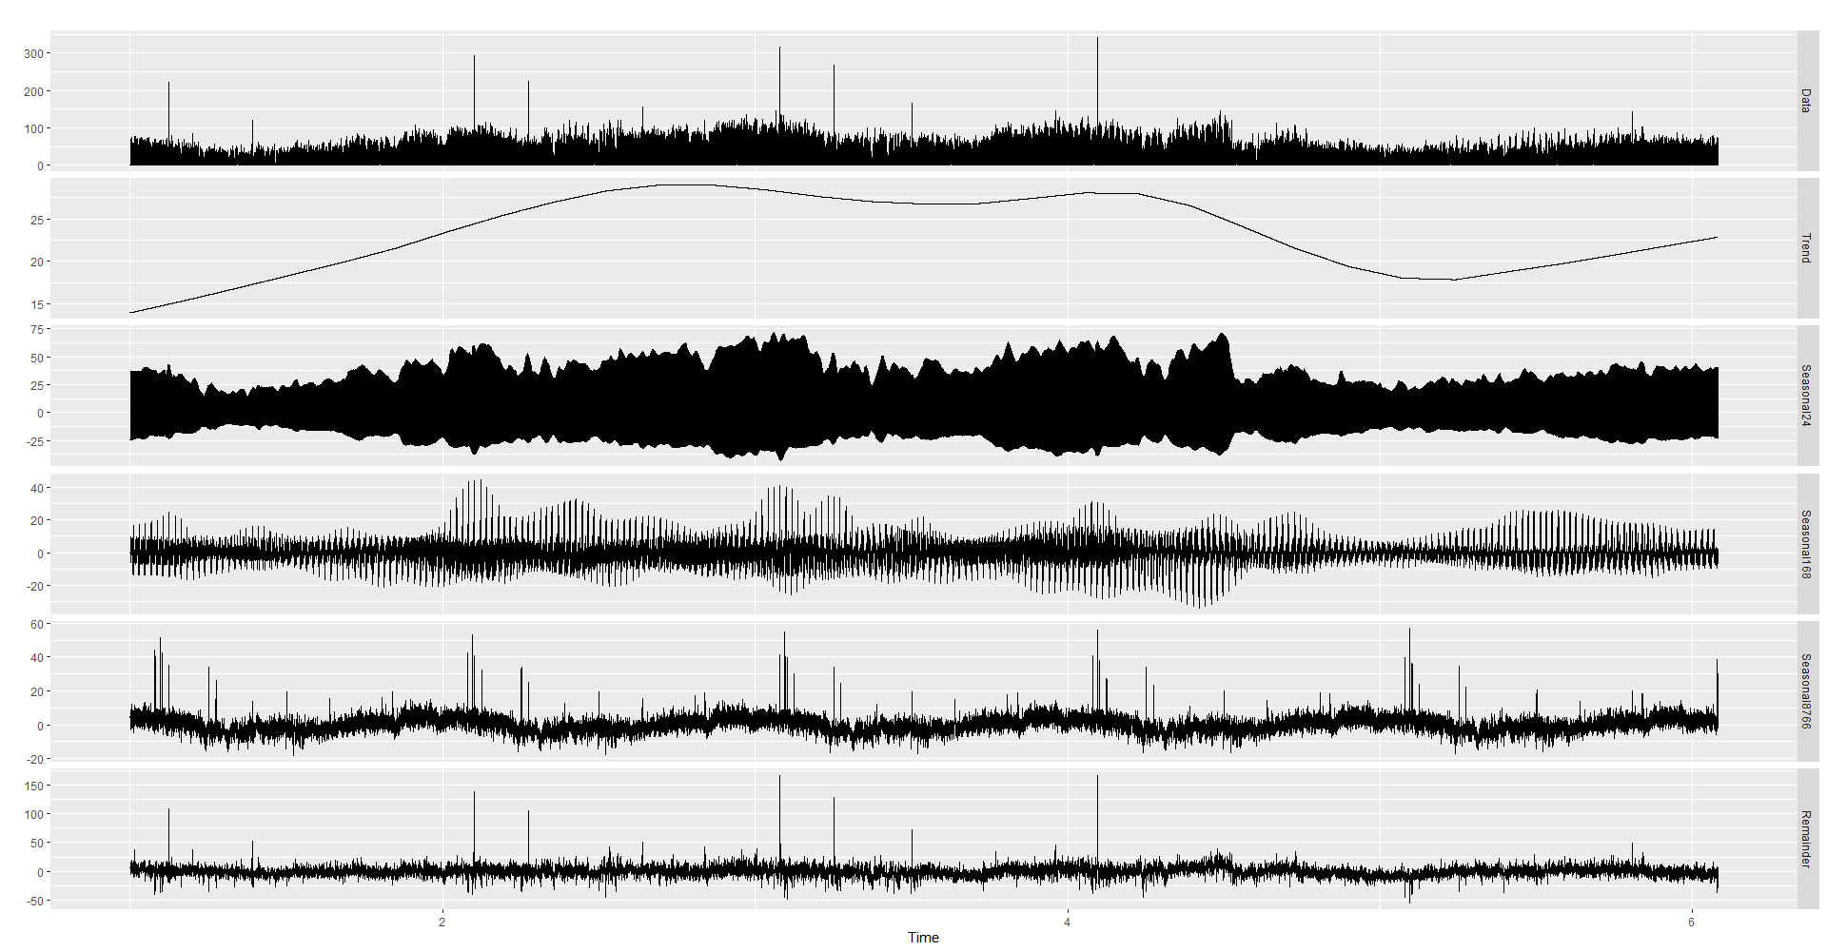

Slide 25
Thanks!

